Slide 1
ERROR HANDLING
Best practice in ASP.NET Web API

Slide 2
Purpose of the presentation
Error handling is often considered a posteriori
Today, Platform handling ≠ Transparency handling
Trace One should use only one error handling model
in order to help obtaining
Well defined scenarios
More predictable system
Easier development

Slide 3
Categories of errors
Error specification
Setting up the API : Models & Controller
Throwing and Catching
Validation Pipeline

Slide 4
Categories of errors
Three categories of errors
Server errors
Client input errors
Client business Errors
Who is responsible ?

Slide 5
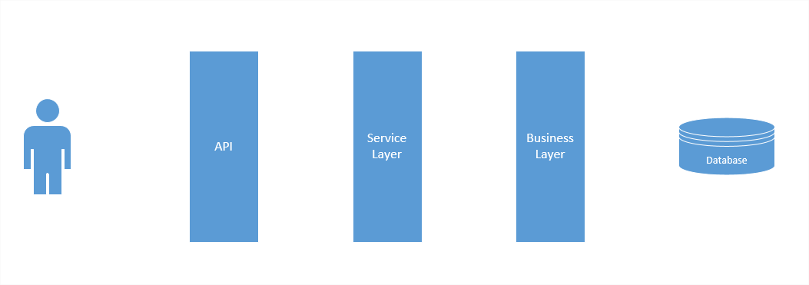

Categories of errors
Server Errors : the server is responsible
System Exception: Could not connect to database

Slide 6
Categories of errors
Server Errors : the server is responsible
null reference exceptions
dictionary not containing keys
unhandled (yet) client errors
timeout exceptions
servers desynchronizations
And many more

Slide 7
Categories of errors
Client input errors : API contract not respected
Price is mandatory

Slide 8
Categories of errors
Client input errors : API contract not respected
Wrong input
Not authorized
Endpoint not found
Price is mandatory

Slide 9
Categories of errors
Client business errors : business rules not respected
Price is too high

Slide 10
Categories of errors
Client business errors : business rules not respected
Price is too high
Object not found
Facility not in your tenant
Data Conflict

Slide 11
HTTP Status
Every HTTP Status gets an HTTP Response Status
HTTP Status have 3 digits
1XX : Informational
2XX : Sucess
3XX : Redirection
4XX : Client Error (input or business errors)
5XX : Server Error

Slide 12
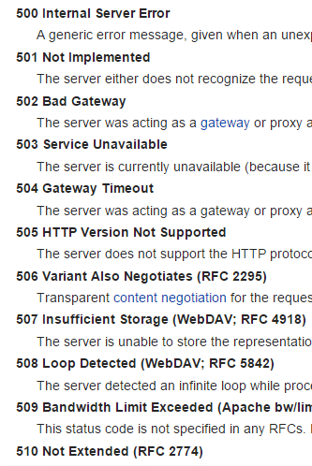
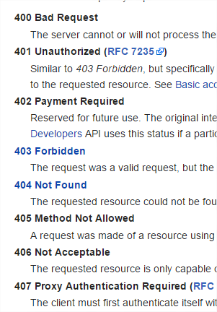
Error HTTP Status

Slide 13
Error Specification

Slide 14
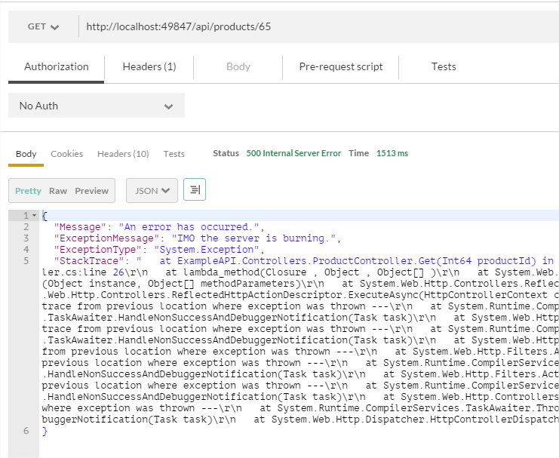
Error Specification
Default ASP.NET Web API errors are not acceptable

Slide 15
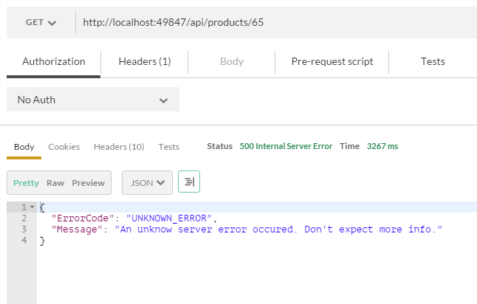
Error Specification
A better format is human readable

Slide 16
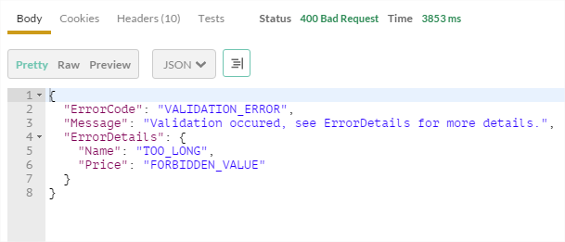
Error Specification
It is flexible for validation

Slide 17
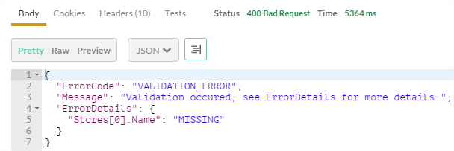
Error Specification
It can handle inner lists or objects

Slide 18
Error Specification
Server errors = minimum info sent to client
System Exception: Could not connect to database

Slide 19
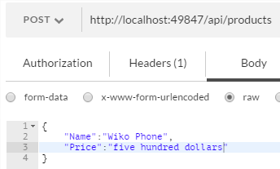
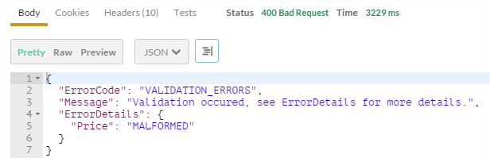
Error Specification
Client errors : Validation error details

Slide 20
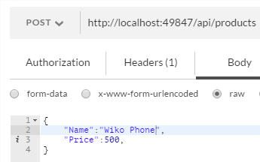
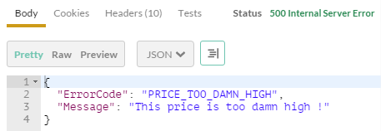
Error Specification
Client errors : Business errors

Slide 21
Setting up the API - Models & Controllers

Slide 22
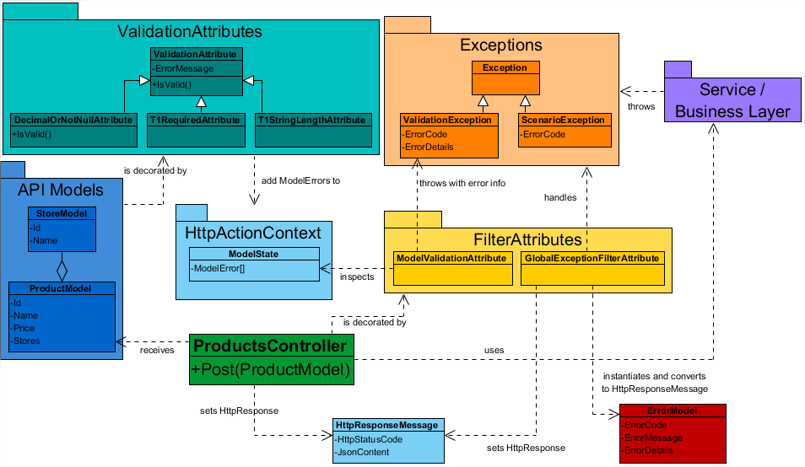
Class Diagram

Slide 23
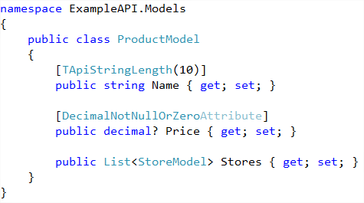
Setting up the API : Models
POCO + Validation attributes

Slide 24
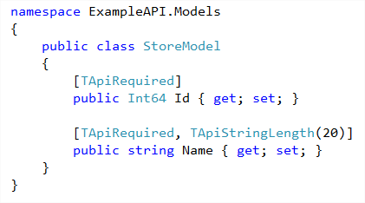
Setting up the API : Models
POCO + Validation attributes

Slide 25
Class Diagram

Slide 26
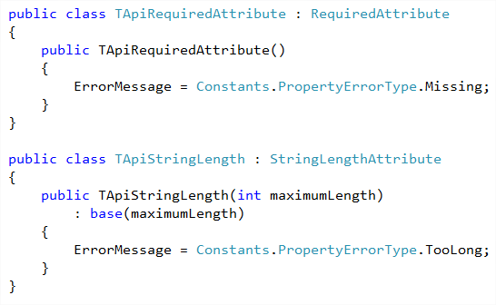
Setting up the API : model attributes

Slide 27
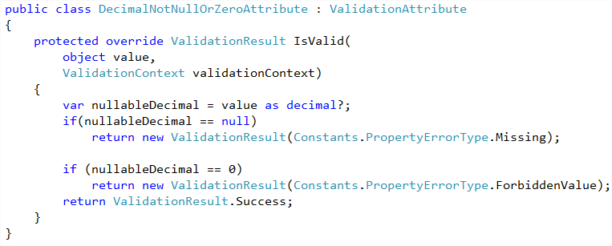
Setting up the API : model attributes

Slide 28
Class Diagram

Slide 29
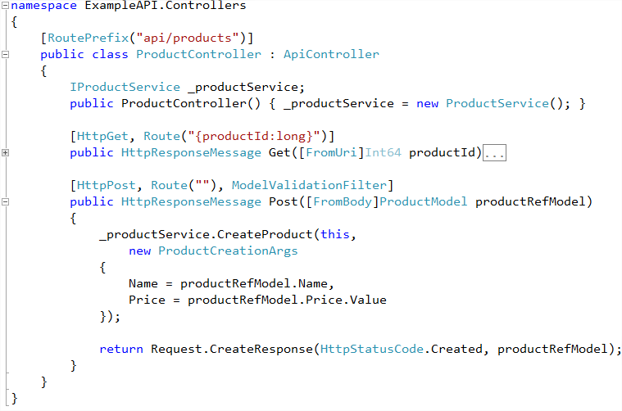
Setting up the API : Controller

Slide 30
Throwing and Catching with Filter Attributes

Slide 31
Class Diagram

Slide 32
Filter Attributes
Filter attributes act as « side code » for actions
(logs, security, validation, exception handling, …)
They can be applied to (or decorating)
Single actions
Entire Controllers
A Whole API
They can run before or after the action

Slide 33
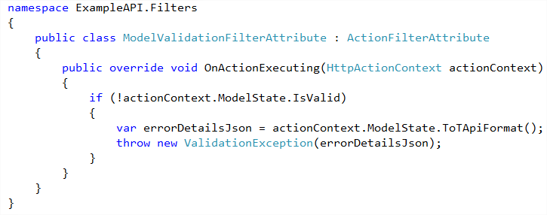
Throwing & Catching : Action Validation Filter
Validation Exception

Slide 34
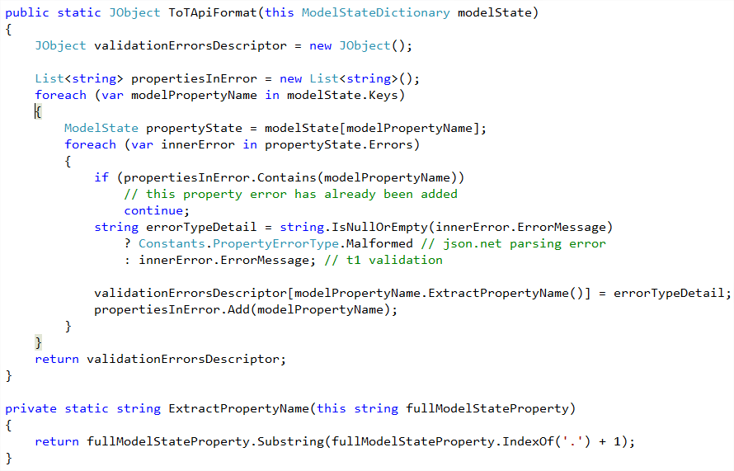
Throwing & Catching : Model Errors Extraction

Slide 35
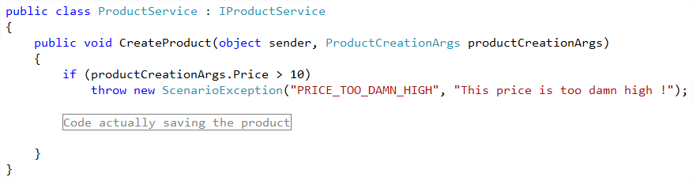
Throwing & Catching : Fake Service Layer
Scenario Exception

Slide 36
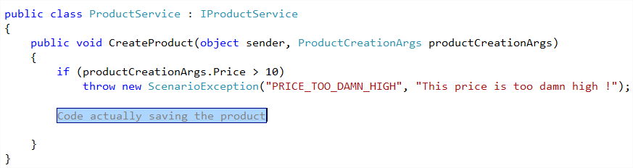
Throwing & Catching : Fake Service Layer
System Exception

Slide 37
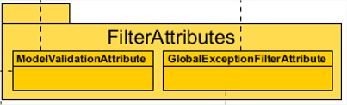
Throwing & Catching
Three Exceptions types get handled
by one single class
Scenario Exception
Validation Exception
System Exception

Slide 38
Class Diagram : Exception Filter attributes

Slide 39
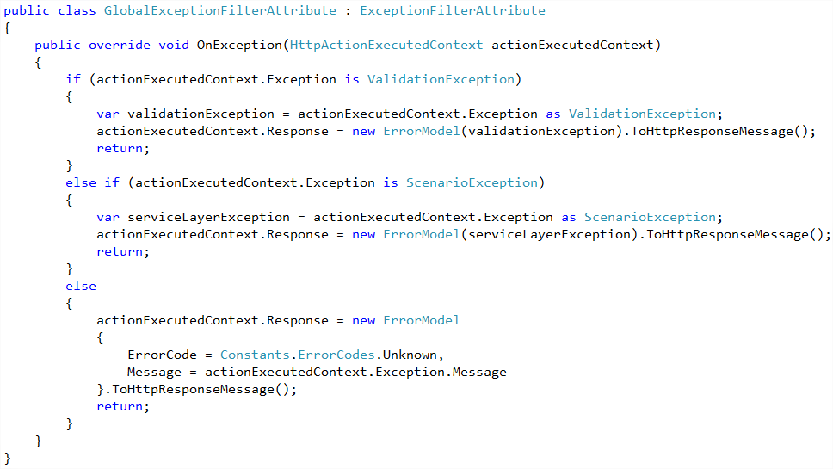
Throwing & Catching : Exception Filter Attribute

Slide 40
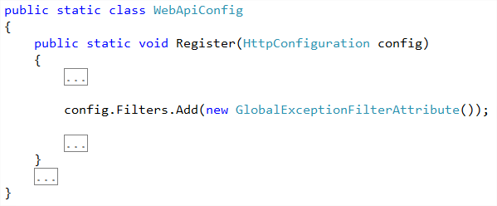
Throwing & Catching : making the filter global
The Exceptions Filter Attribute is applied to the entire API

Slide 41
Class Diagram : Exceptions

Slide 42
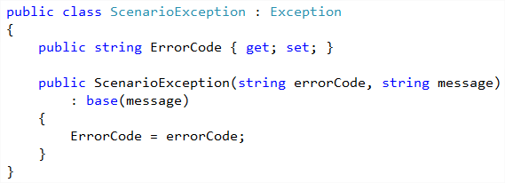
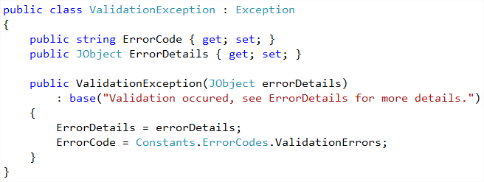
Throwing & Catching: Exceptions

Slide 43
Class Diagram : Error Model

Slide 44
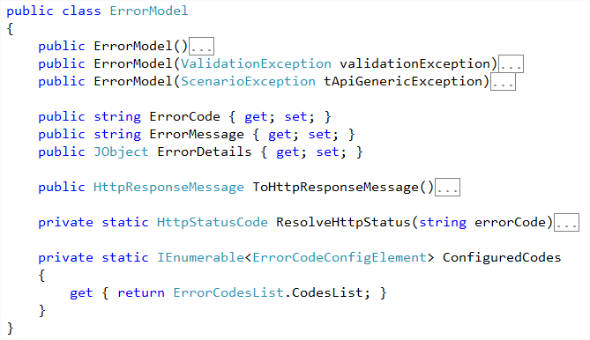
Class Diagram : Error Model

Slide 45
Some Sequence Diagrams

Slide 46
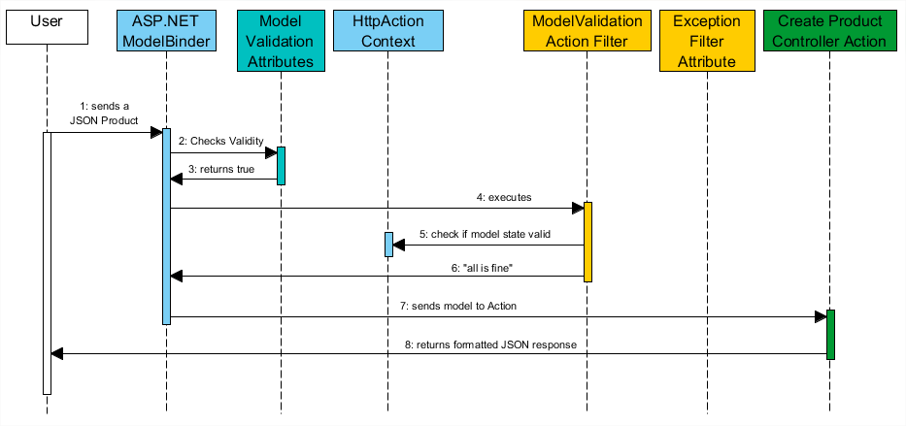
Nominal scenario

Slide 47
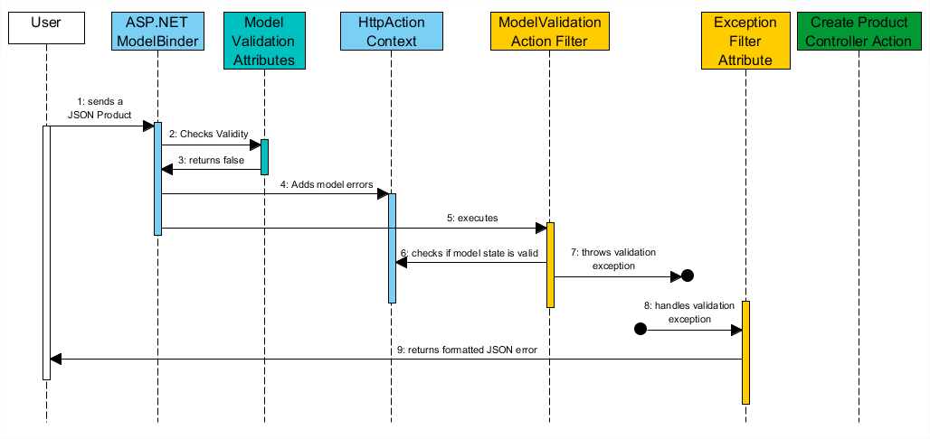
Validation errors

Slide 48
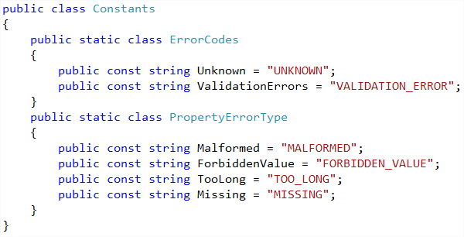
Helpers & Converters : Constants

Slide 49
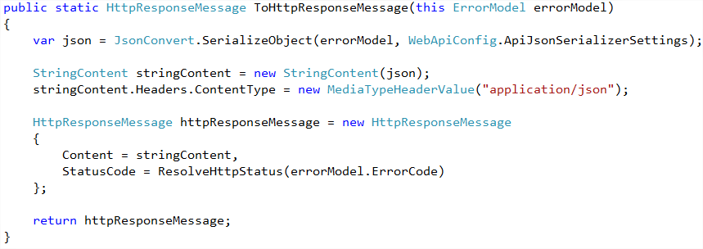
Helpers & Converters : HttpResponse Message conversion

Slide 50
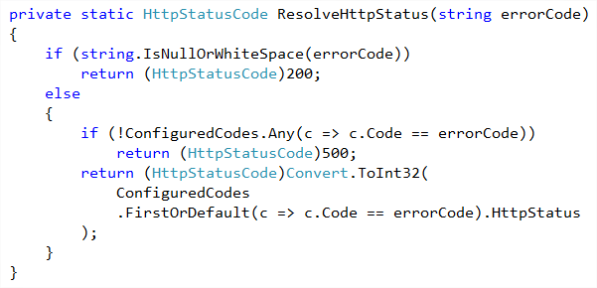
Helpers & Converters : HttpResponse Message conversion

Slide 51
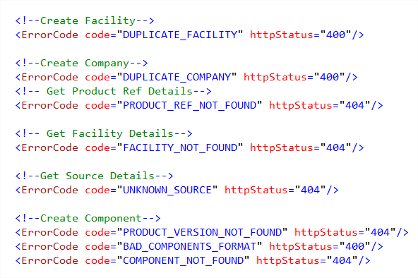
Helpers & Converters : Custom Error Config Section

Slide 52
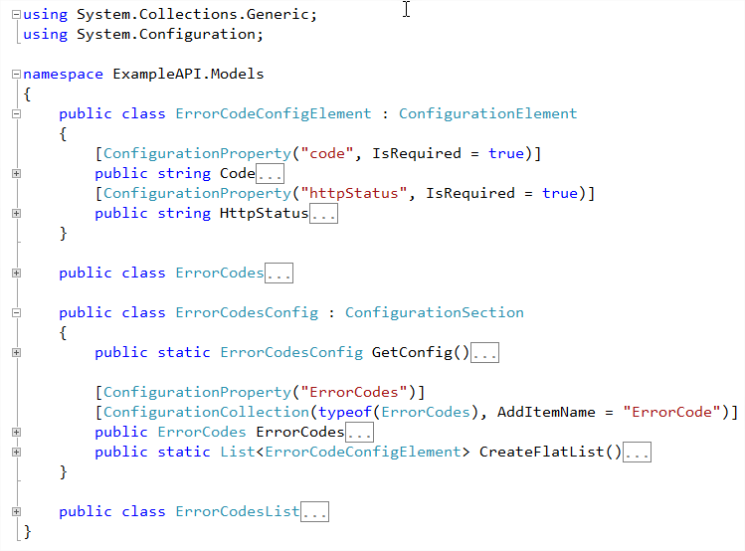
Helpers & Converters : Custom Error Config Section

Slide 53
Areas for improvement
JSON input validation : JSON Schéma ?
Using Dictionary to retrieve client error messages

Slide 54
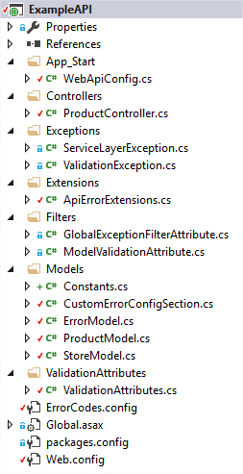
Example Solution
I created an example solution using this Error Handling System

Slide 55
Do you have questions ?

